Slide 1

Learn CSS
Lesson 6
Height and Width in CSS
For more information visit
https://bptechnical2020.blogspot.com/

Slide 2
Contents
What is height and width in css?
Height property
Width property
Min-height property
Max-height property
Min-width property
Max-width property

Slide 3
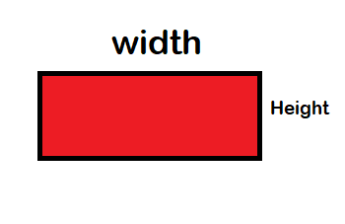
Height and width in CSS
In the image above we can understand what is height and what is width. Height is the vertical space taken by a element. And width is the horizontal space taken by any element. The default width of a block level element is 100% width of its parent. And the height is auto, that is it takes the space required by its content.

Slide 4
Thank you for watching!
If you like this video please share and subscribe. Please comment your suggestions.

